Slide 1

Data Science 01
COMP 3122
Reza Dibaj

Slide 2
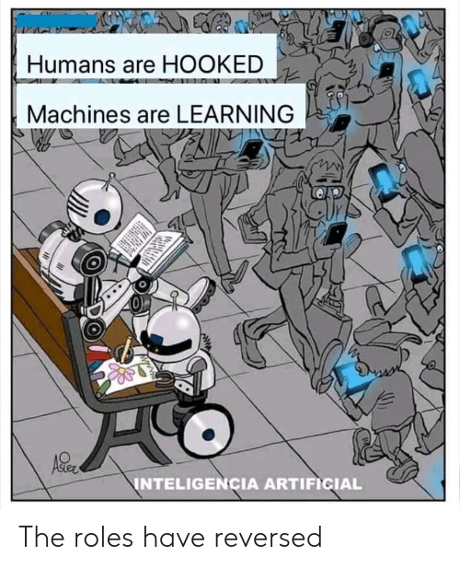

Slide 3
Previous Semester Resources
All the resources are available on the following link:
https://github.com/jakevdp/PythonDataScienceHandbook
The main reference (reading online):
https://jakevdp.github.io/PythonDataScienceHandbook/
Book structure - Python libraries
IPython & Jupyter
NumPy
Matplotlib
Pandas
Scikit-learn

Slide 4
Previous Semester Resources
Course outline: We will provide a new version together.
Personalizing → George Brown 2022
The foundations is based on the previous version:
https://www.georgebrown.ca/CO/gbc/technology/school-of-computer-technology/courses/COMP/3122/COMP-3122-T127.html
Another version of the Course Outline:
https://github.com/kamrik/ML1/blob/master/Outline.md

Slide 5
My Contact Info & Office Hours
Email: Reza.Dibaj@GeorgeBrown.ca
Office hours: One hour after your lab sessions

Slide 6
Marking Scheme
5 Assignments 50% Total (10% Each)
Class Activities 10%
Midterm Exam 10% A session before the intersession
Final Exam 10% Week 12 (2 session before the end)
Project 20%
Bonus Quizzes 10%

Slide 7
Why we study…
We need motivation for what we do.… for what we learn….
https://www.youtube.com/watch?v=01ZCnCXpG4A
https://www.youtube.com/watch?v=0r1LTe5KkSA

Slide 8
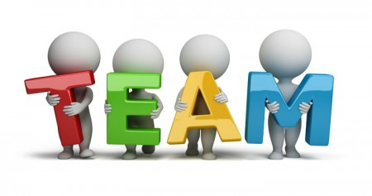
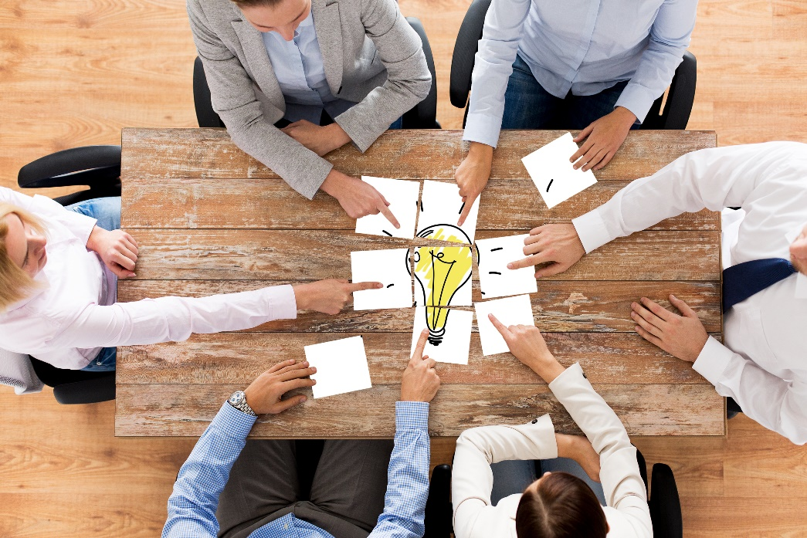
Team Making and Project Definition
We find our team members in one week and define our project in two weeks…

Slide 9

Now, it is your turn…
Please let me know what you think.
As a coach, how can I be any help.
Notes:
Finding our own goals and projects…
Learning Python to the fullest…

Slide 10
This course is not about ….
General Purpose AI
Pure Big Data Concept
Cloud Computing

Slide 11
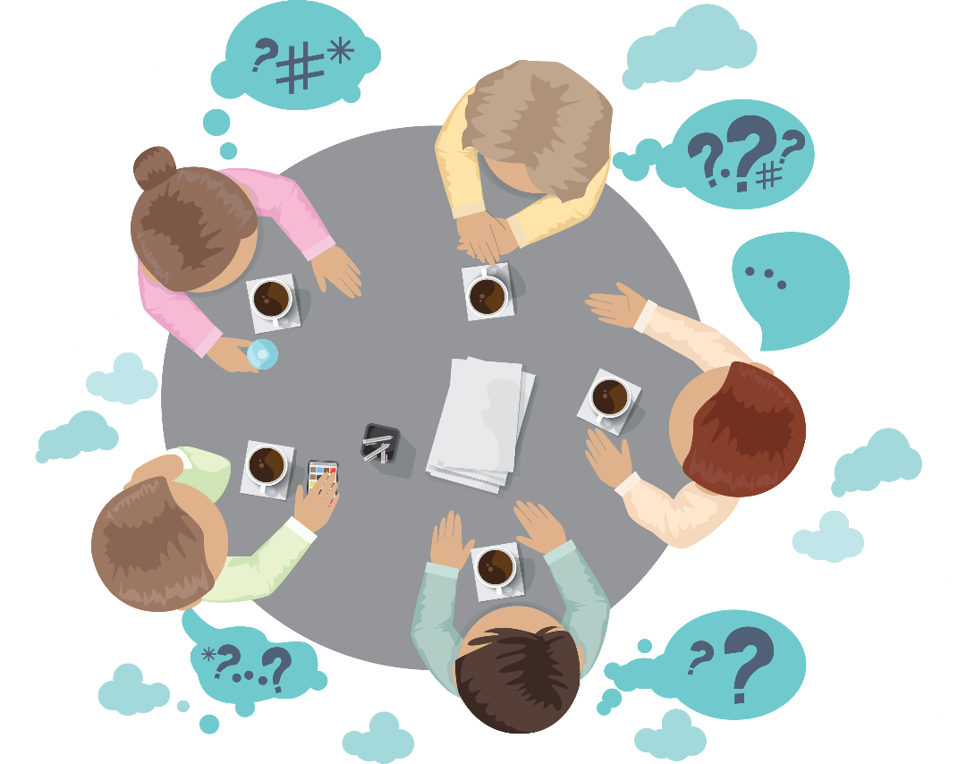
Group Discussion
Please spend a few minutes with your team members explain what the intelligence is.

Slide 12
What is intelligence?
The ability to acquire and apply knowledge and skills.
Oxford Dictionary
How do we acquire knowledge?
How does a two-year old baby learn?

Slide 13

Quick Review of Whole IT in One Slide
Operating Systems
System S/W
Utilities
Software
Languages
Super High Level
Applications
High Level
Computer
Middle Level
Low Level
Hardware

Slide 14
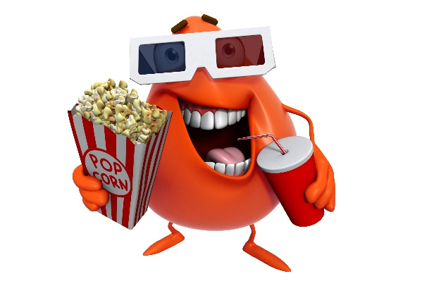
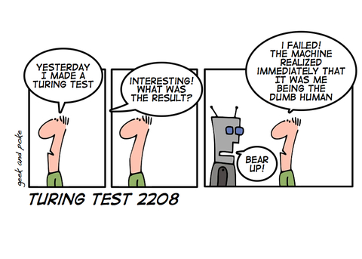
Brief history of AI
Myth of Talos (https://en.wikipedia.org/wiki/Talos)
Turing Test – 1950s
Video 1
Video 2

Slide 15
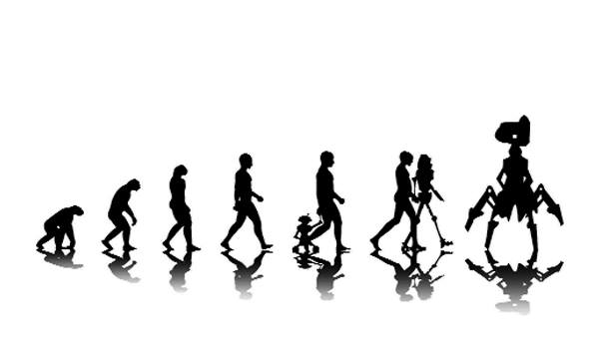

Slide 16
Brief history of AI
Asimov's Three Laws of Robotics – 1950s
A robot may not injure a human being or, through inaction, allow a human being to come to harm.
A robot must obey the orders given it by human beings except where such orders would conflict with the First Law.
A robot must protect its own existence as long as such protection does not conflict with the First or Second Laws.

Slide 17
Brief history of AI
Dartmouth Conference 1956: the birth of AI
The Term Artificial Intelligence discussed and accepted
The proposal for the conference said, “The study is to proceed on the basis of the conjecture that every aspect of learning or any other feature of intelligence can in principle be so precisely described that a machine can be made to simulate it.”

Slide 18
Brief history of AI
The AI winters - late 70s and 80s
Boom and bust cycles of extreme enthusiasm followed by disappointment

Slide 19

Brief history of AI
Modern times – Machine Learning and Deep Learning
Video 1
Video 2

Slide 20
Suggested Movies
Hello World Canada: The Rise of AI
The Imitation Game (2014)
2001: A Space Odyssey (1968)
Modern Times by Charlie Chaplin (1936)
The Great Dictator by Charlie Chaplin (1940)

Slide 21
Group Discussion
Artificial Intelligence, Machine Learning, Deep Learning and Data Science …. What are the differences between these terms?

Slide 22
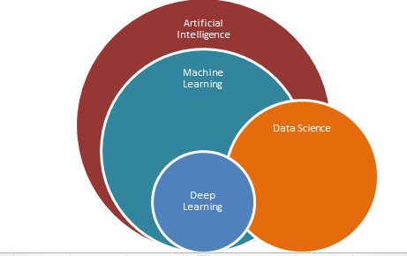
Artificial Intelligence, Machine Learning, Deep Learning and Data Science
For now, we need to have an overall view as follows….
Data Science→ Making sense of data, visualization, ….

Slide 23
Group Discussion
Please spend a few minutes with your team members explaining a few application of Machine Learning in real life. Have you ever used it?
Where?
How?

Slide 24
What is Data Science?
Movie time… YAY!
Data Science In 5 Minutes

Slide 25
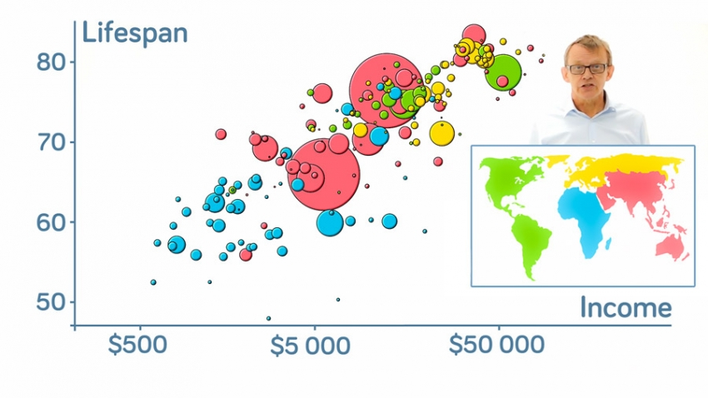
What is Visualization?
Amazing example… Let’s enjoy!
Hans Rosling's 200 Countries, 200 Years, 4 Minutes
“Let my dataset change your mindset.” -Hans Rosling

Slide 26
Why study Machine Learning (ML)?
Common industrial applications
Recommendation engines (AKA Customer Recommendation System) (Netflix, Amazon)
Ad targeting (Google, Facebook, Cambrdge Analytica)
Spam filtering
Credit card fraud detection
Pattern recognition in sensor data (FitBit)

Slide 27
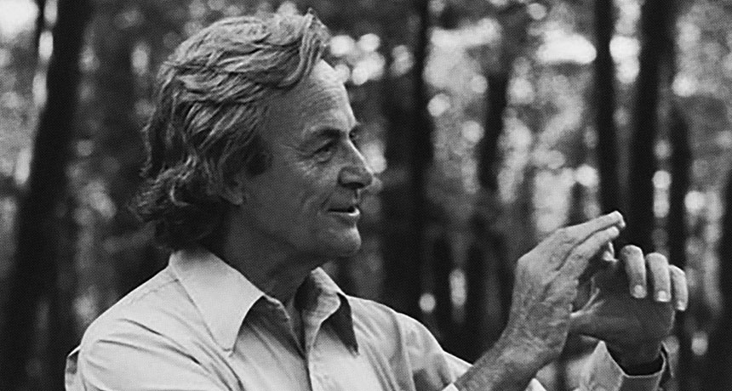
“What I cannot create, I do not understand.”- Richard Feynman

Slide 28

Skimming our Reference Book

Slide 29
Important Notes on Python
Online Jupyter:
https://jupyter.org/try
Quick Python Recap:
https://learnxinyminutes.com/docs/python3/
On of the best quickest recap videos which was mentioned in the python official web site:
https://www.youtube.com/watch?v=_uQrJ0TkZlc
One of the best series of videos on pandas:
https://www.dataschool.io/easier-data-analysis-with-pandas/

Slide 30


How to get pandas….
The best way is to install Anaconda Distribution
Which contains all pandas dependencies….
https://www.anaconda.com/distribution/
You can follow the steps in the

Slide 31
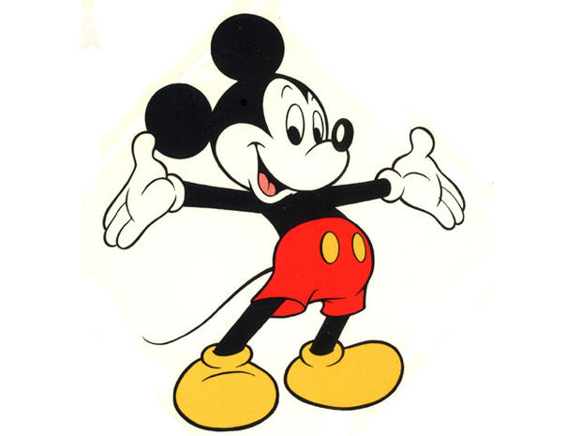
Cartoon: Learning Machine Learning
The following is a nice cartoon to read and learn more about Machine Learning :)
https://cloud.google.com/products/ai/ml-comic-1/

Slide 32

Thank you
Question?
To be
Not to be

Slide 33

Appendix:
Installation Process of
Anaconda Distribution of Python on Windows

Slide 34
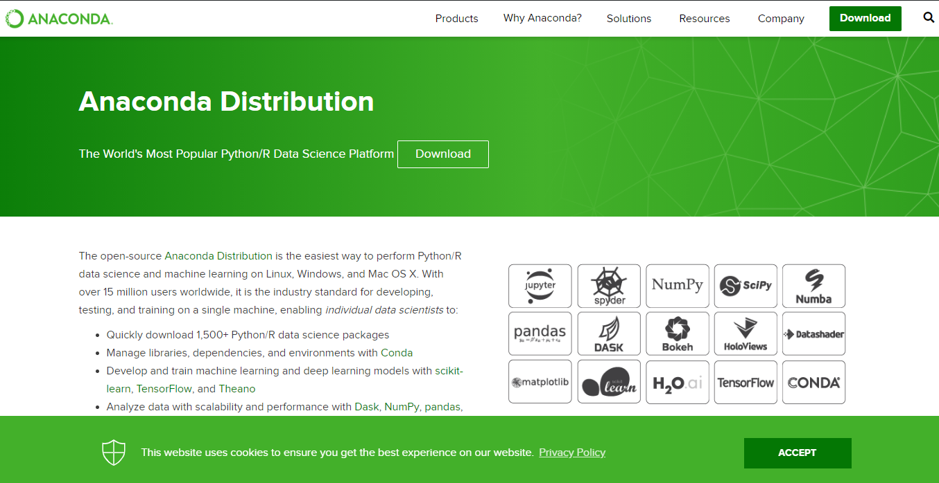
Anaconda Distribution of Python
Notes:
https://www.anaconda.com/distribution/

Slide 35
Anaconda Distribution of Python
2
1

Slide 36
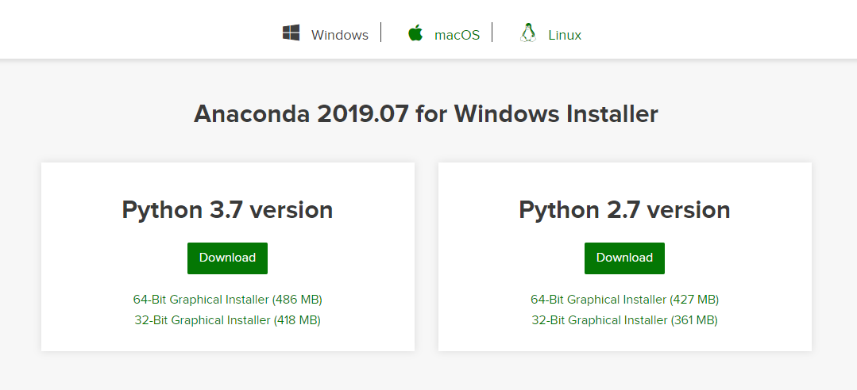
Anaconda Distribution of Python
1
2

Slide 37
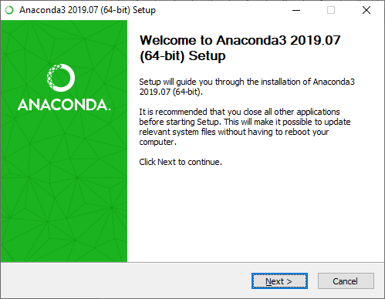
Installation Process
1
2

Slide 38
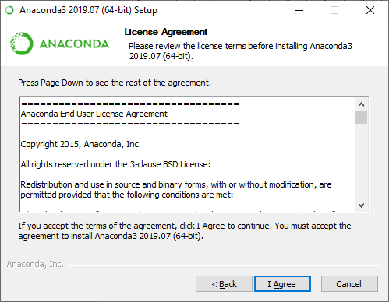
Installation Process

Slide 39
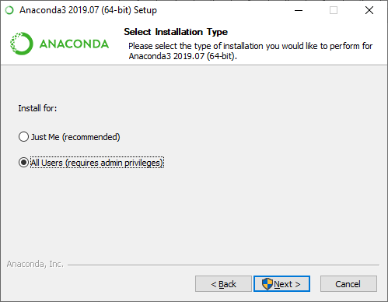
Installation Process
1
2

Slide 40
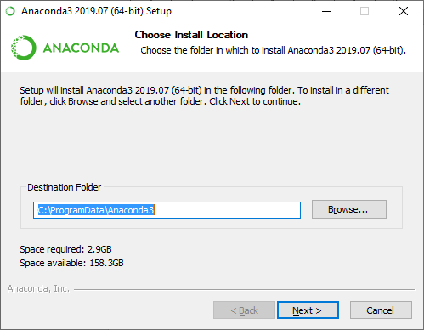
Installation Process
You can change the installation path or leave it as it is.
1
2

Slide 41
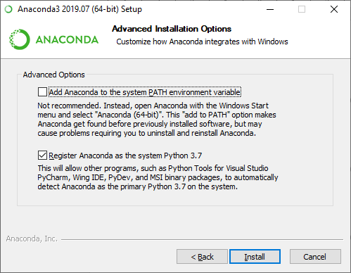

Installation Process

Slide 42
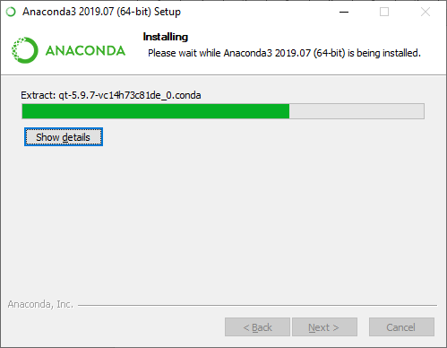
Installation Process

Slide 43
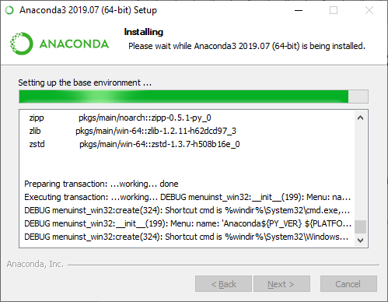
Installation Process

Slide 44
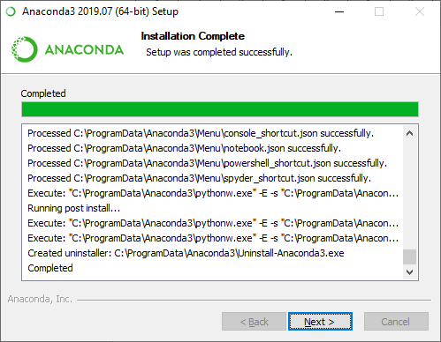
Installation Process

Slide 45
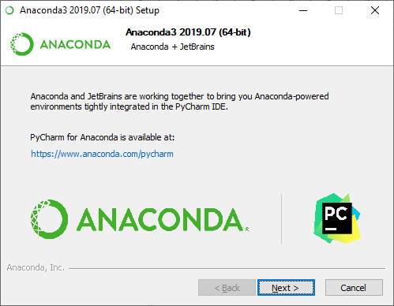
Installation Process

Slide 46
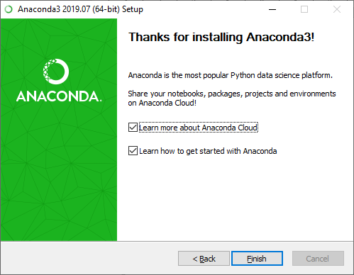
Installation Process

Slide 47
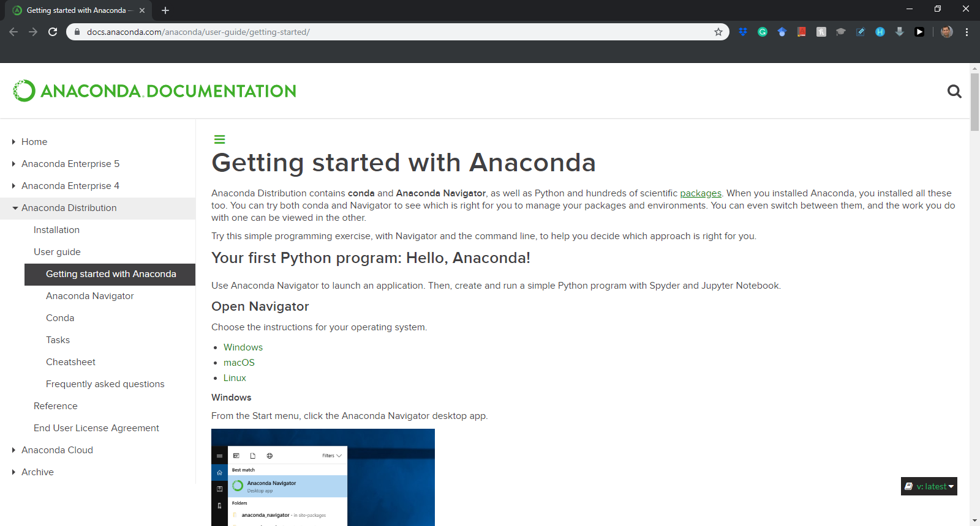
Installation Process
Notes:
https://docs.anaconda.com/anaconda/user-guide/getting-started/

Slide 48
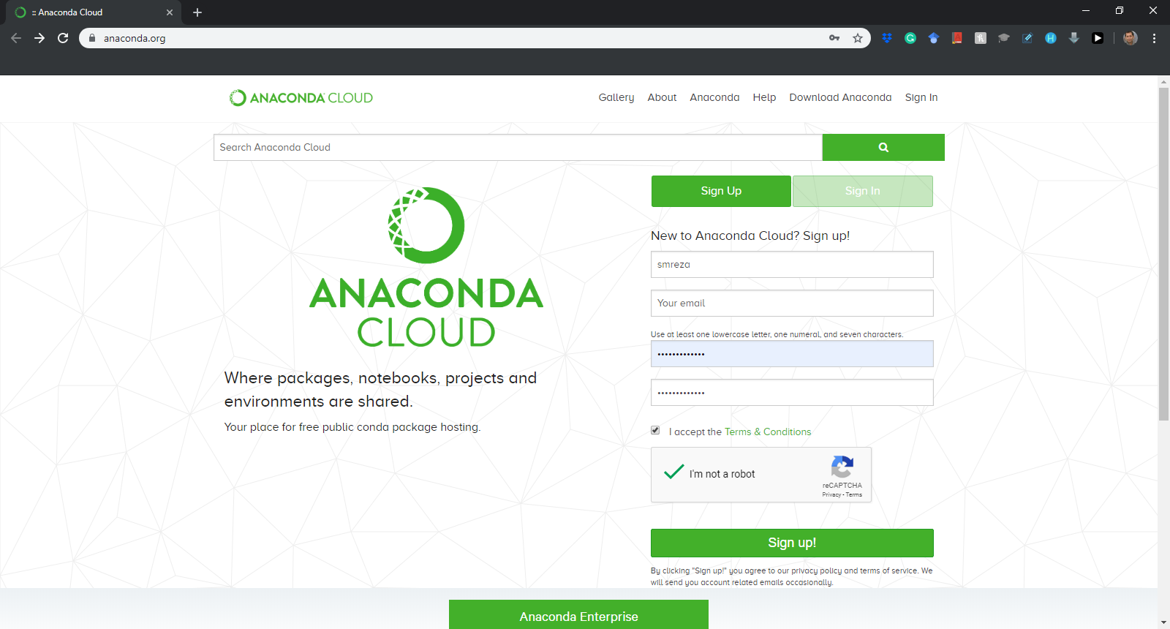
Installation Process
Sign up for the first time….
Notes:
https://anaconda.org/

Slide 49
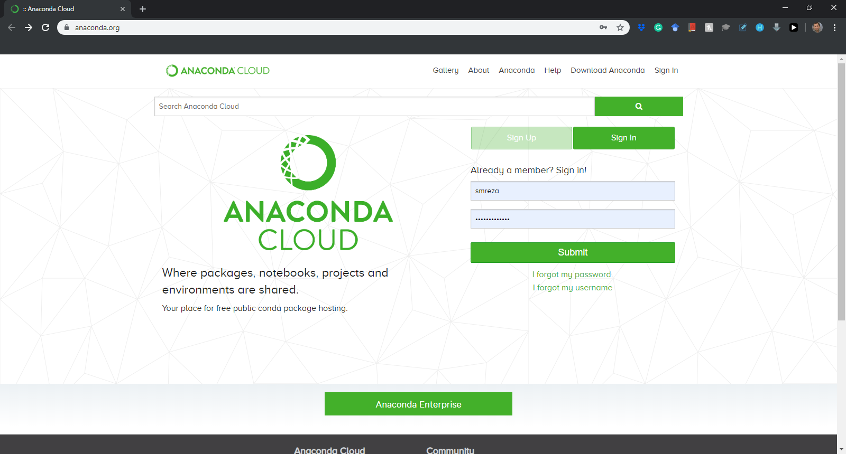
Installation Process
Sign in after the first time….
Notes:
https://anaconda.org/

Slide 50
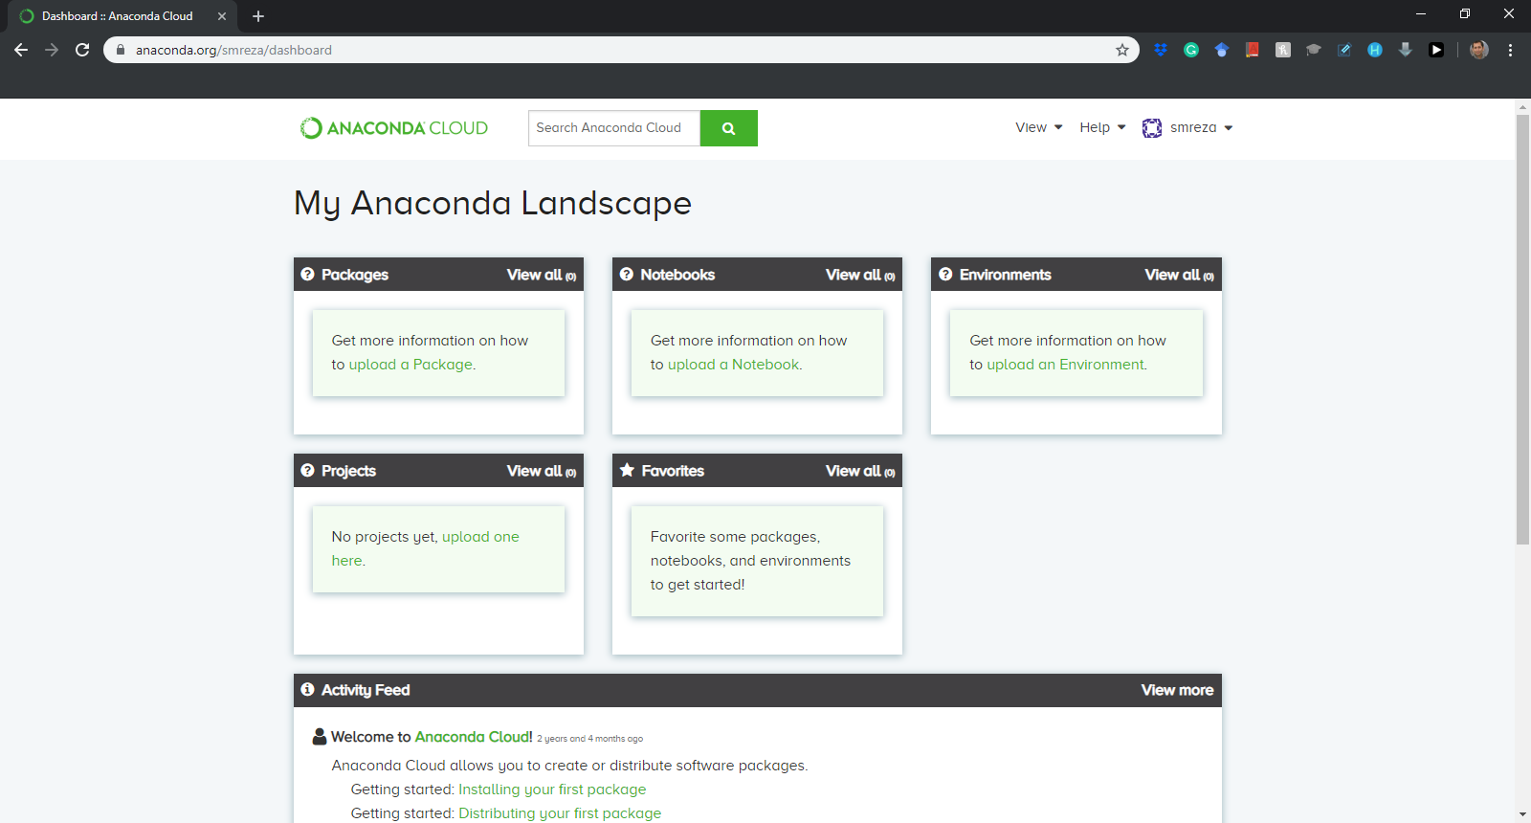
Installation Process

